Slide 1
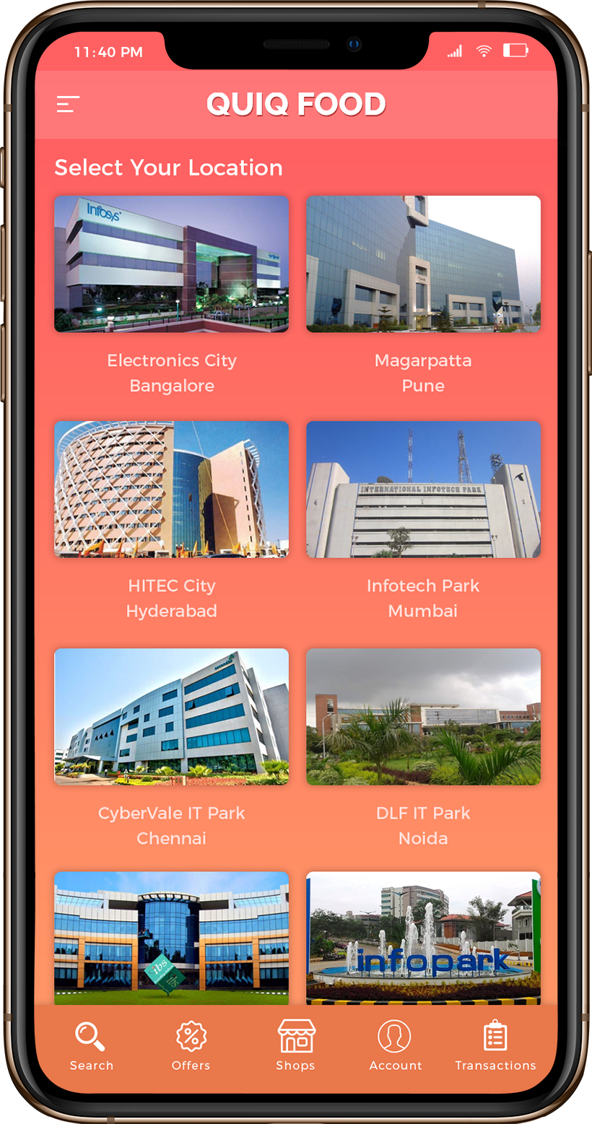
Select Your Location
To identify available shops at you preferred location & to take an order.

Slide 2
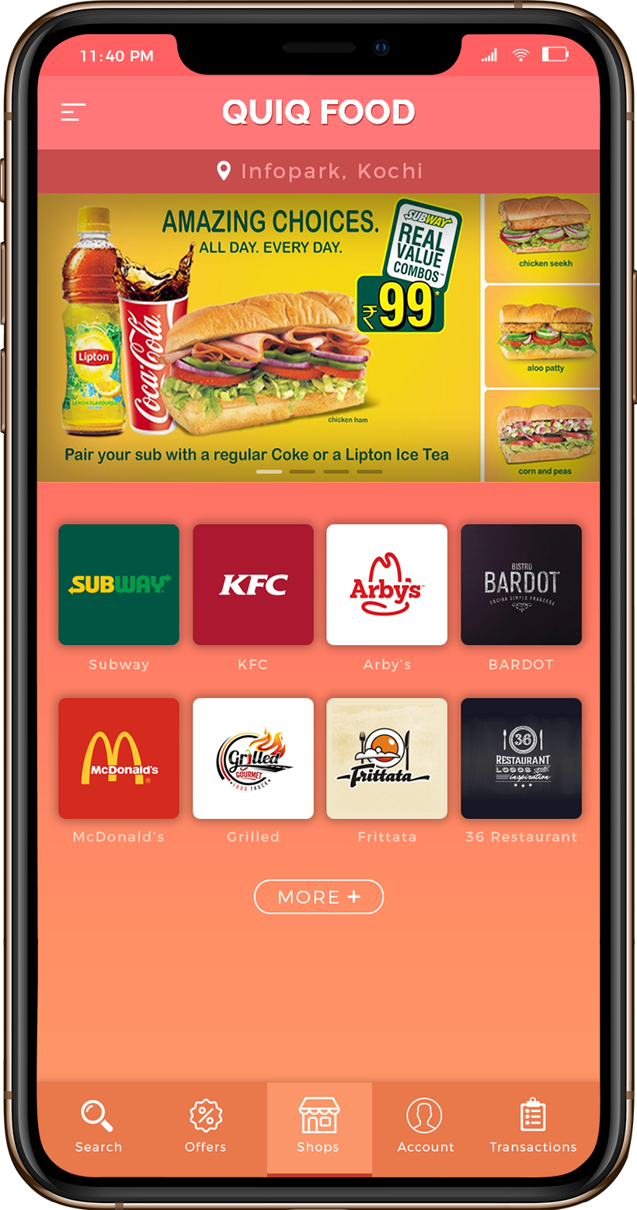
Shops
Where you find your shops based on selected location

Slide 3
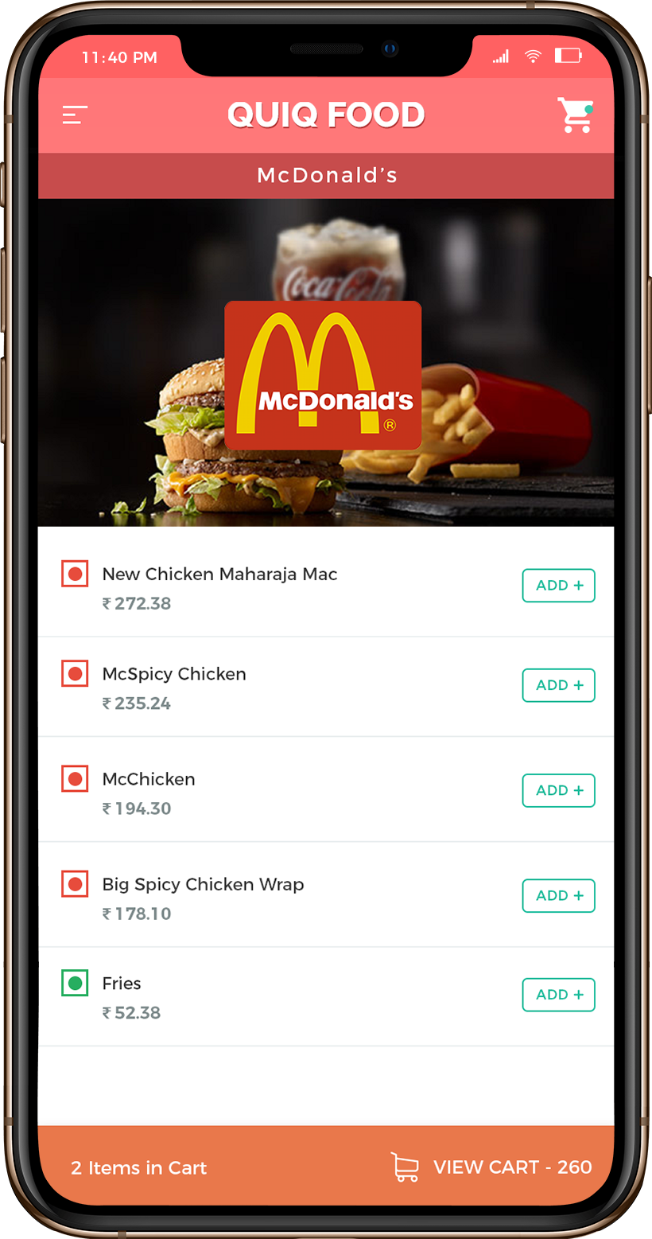
Restaurant Menu
Choose your favorite shops menus & add to cart.

Slide 4
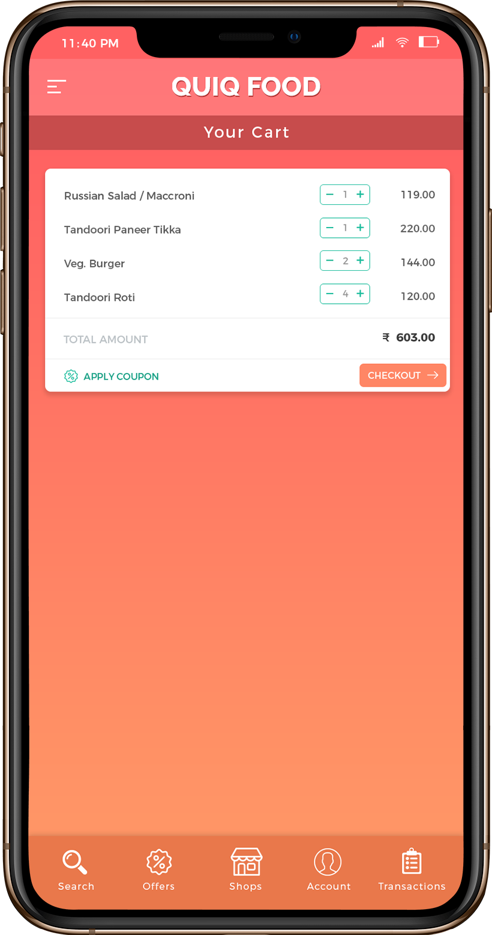
Shopping Cart
You can select items from different shops and proceed to checkout.
More Easy & Convenient way to order from multiple point of sale

Slide 5
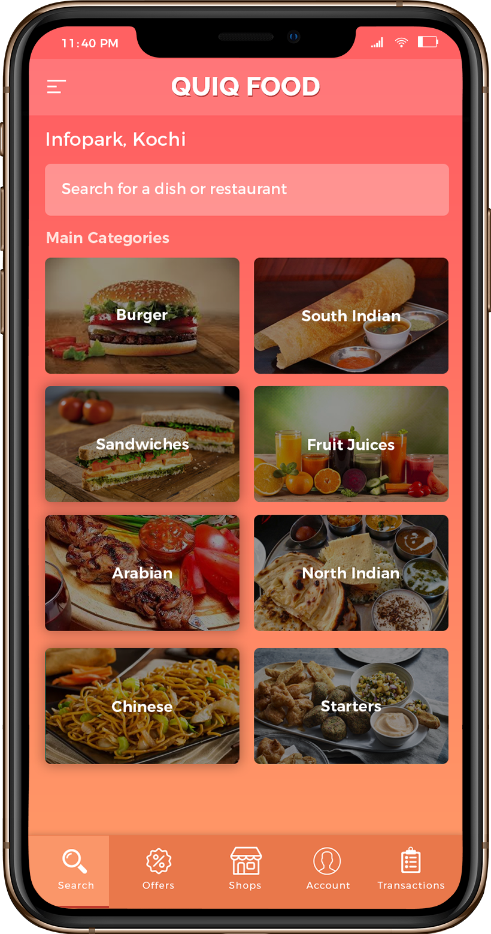
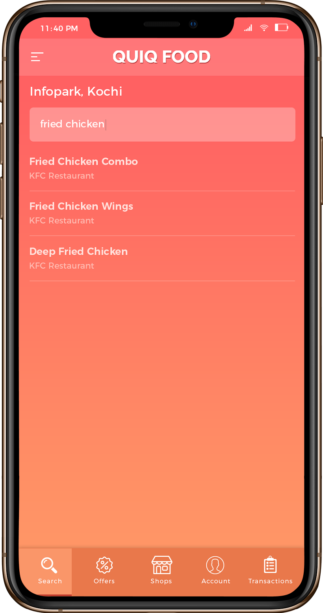
Search
Identify
Order
More way to filter your search by item name, shops & categories

Slide 6
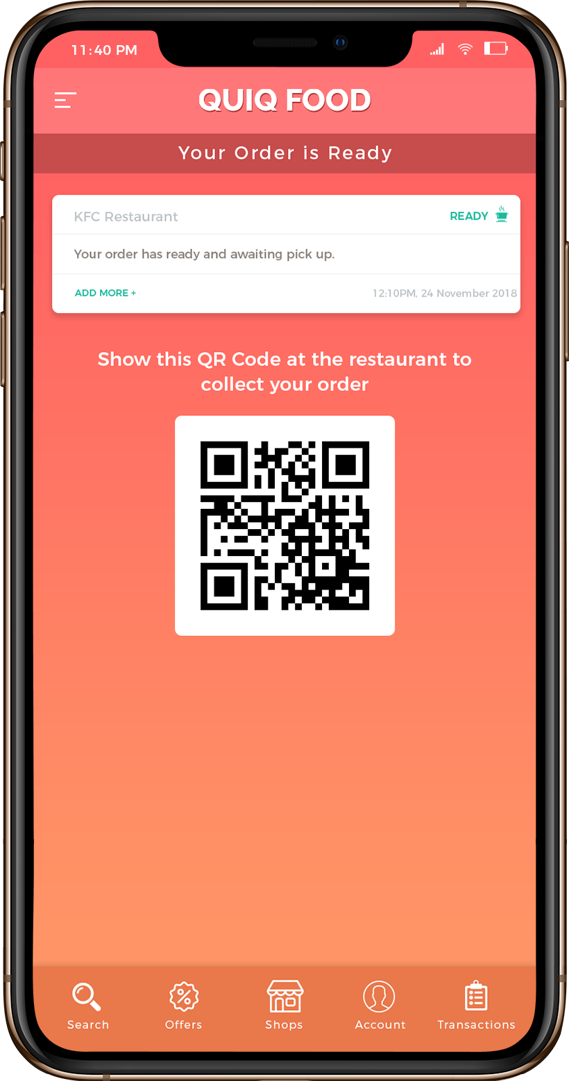
QR Code for Delivery
Show the QR code generated after your successful payment to deliver the items.

Slide 7
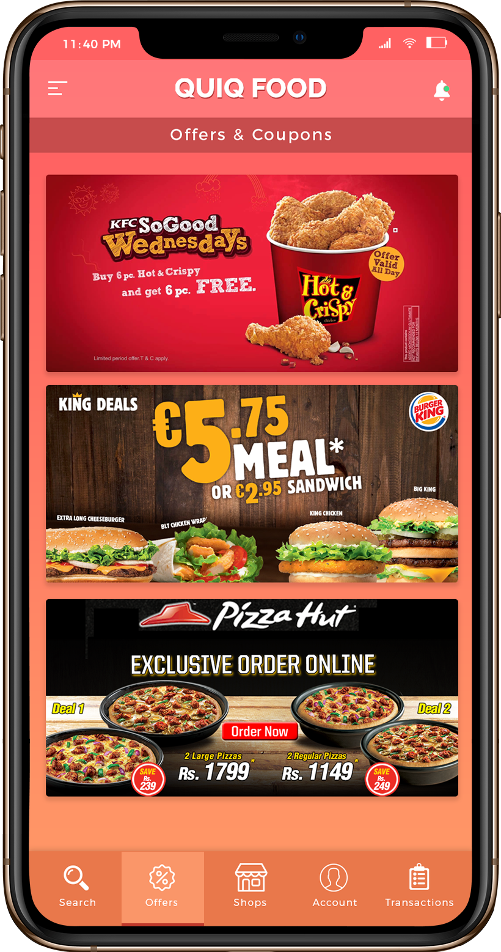
Offers & Coupons
Find your offers based on your current location & shops

Slide 8
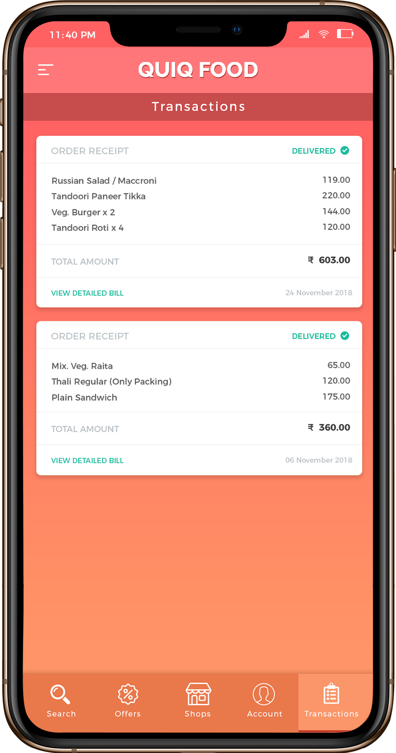
Find your transactions,
Reorder your favorite menu

Slide 9
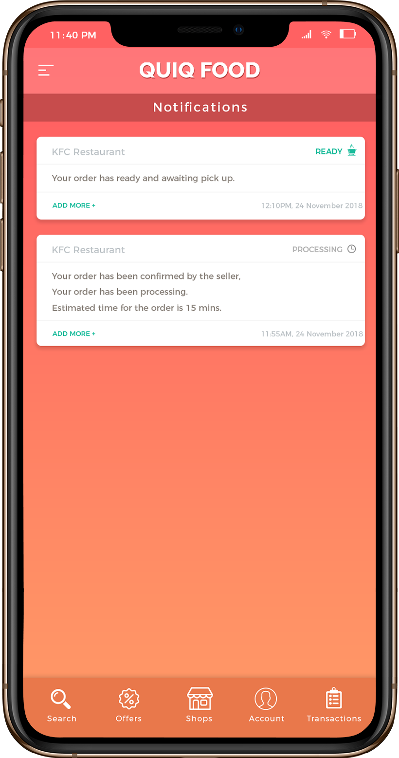
Track on Notification
You will be notify on your transactions, order status or any occasional updates.

Slide 10
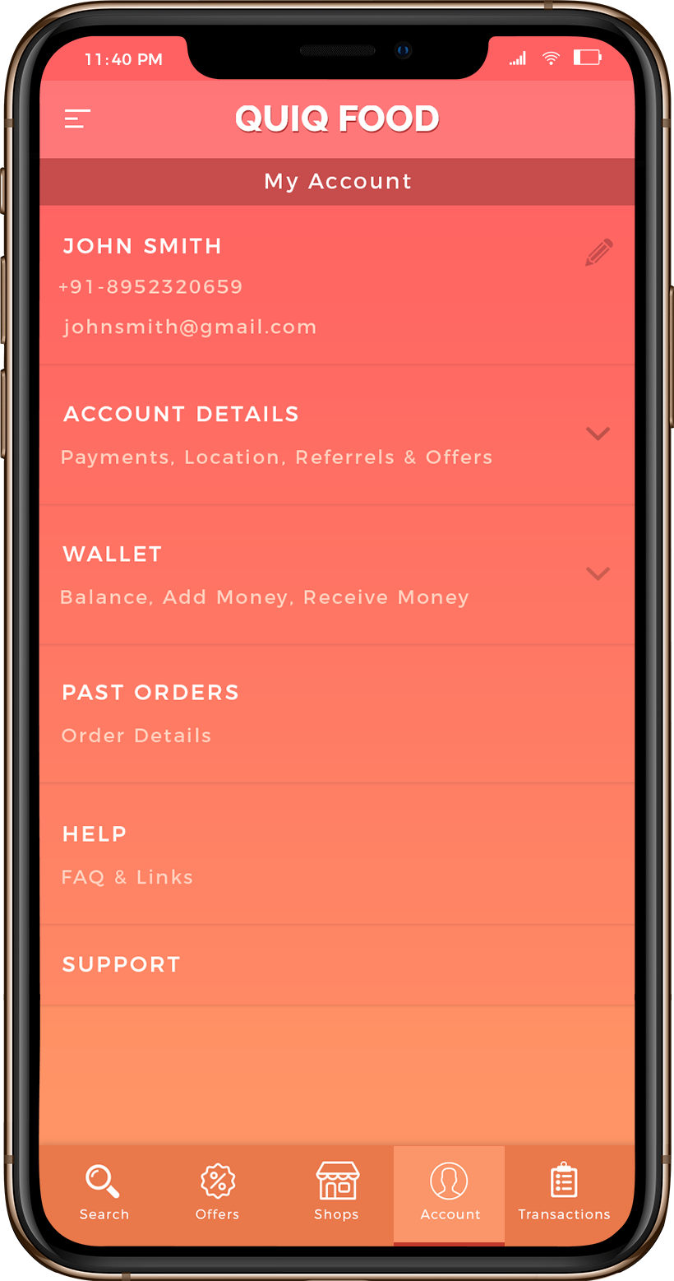
My Account
You can manage your profile, account information, wallet, past orders, Help, support

Slide 11
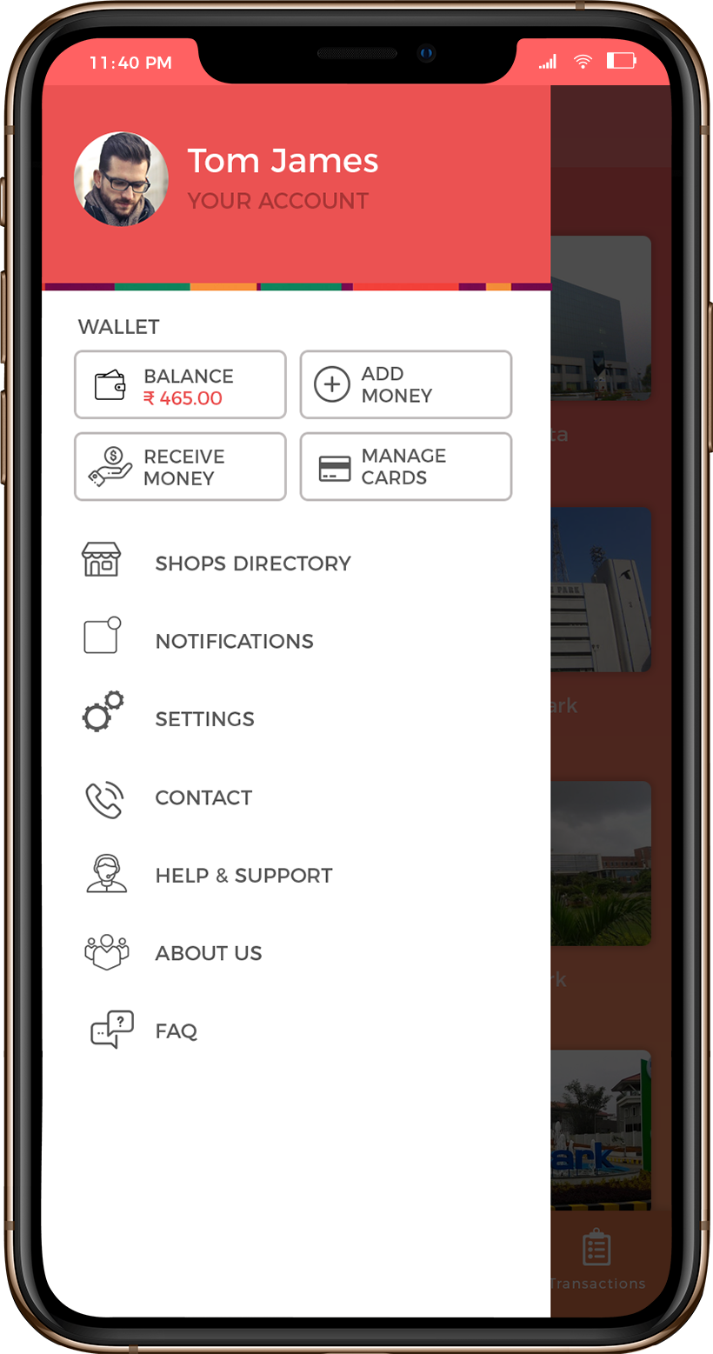
More on options
Where you find more options like wallet, settings, support, aboutus, faq etc.

